Slide 1
WildLife Trade
Northwestern Data Science Bootcamp
Project I
Tuesday, March 27th 2018
Participants:
Alexandria C.
Elise L.
John E.
Grace Z.

Slide 2
About the Dataset
About the Dataset
Over 13 million records
CITES is one of the oldest conservation organizations in existence
5000 animal species and 29000 plant species
CITES Database Wildlife Trade
This unique dataset records all legal species imports and exports carried out in 2016 (and a few records from 2017) and reported to CITES. Species not on the CITES lists are not included; nor is the significant, and highly illegal, ongoing black market trading activity.

Slide 3
Dataset Limitations
Not all species covered
Variables reported differently between Importers/Exporters
Too many unreported values/trades
Few records from 2017
IMPORTANT!
To clarify, most of the following plots are not weighted against the actual traded amounts. Every transaction has the same "value", regardless of the trade volume. This may lead to skewed results.

Slide 4
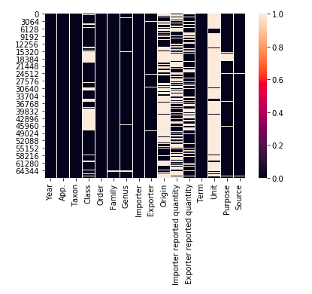
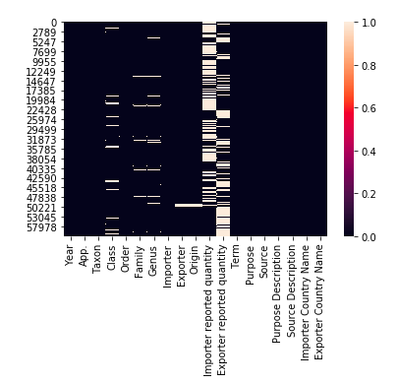
Cleaning the Data
Fill the Blanks
Fill the null values in Origin. Origin is same as Exporter if Origin is unreported
03
Pre-Treatment
Remove “Unit” column with 89.67% null values. Drop rows with “0” quality
Remove duplicates
Analyzing what’s needed
Remove unneeded dataset: the plant (Source is 'A') Add codes description for countries, source, purpose
01
02

Slide 5
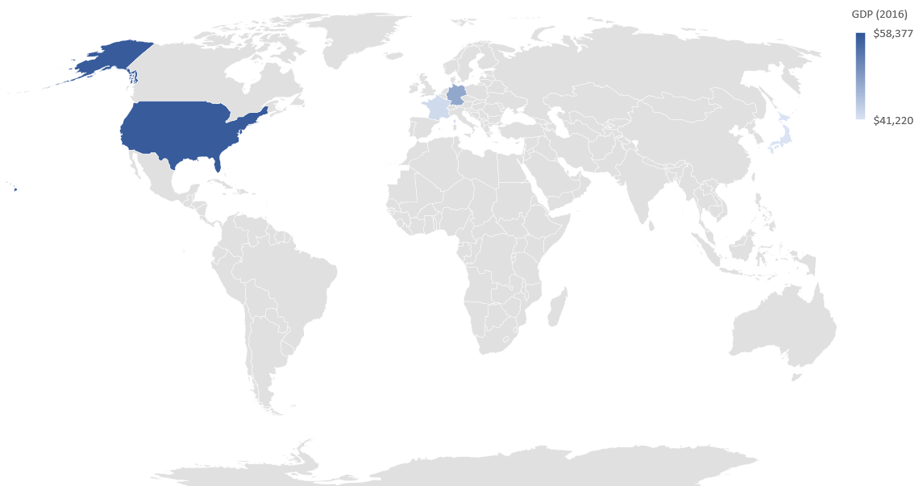
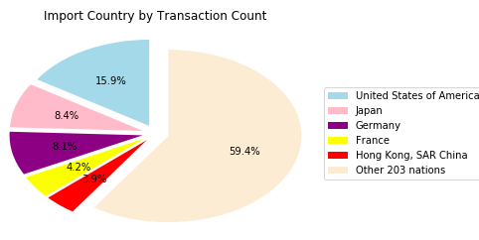
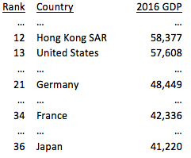
Are the wealthiest countries the biggest importers?
Top Importers vs 2016 GDP (223 countries)
None of the top 5 importers are in the top 10 countries with the highest GDP’s.

Slide 6
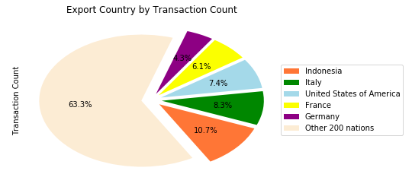
Are the equatorial countries the biggest exporters because they have more biodiversity?
The only country from the top 5 that is close to the equator is Indonesia, which is home to some of the highest biodiversity levels in the world.

Slide 7
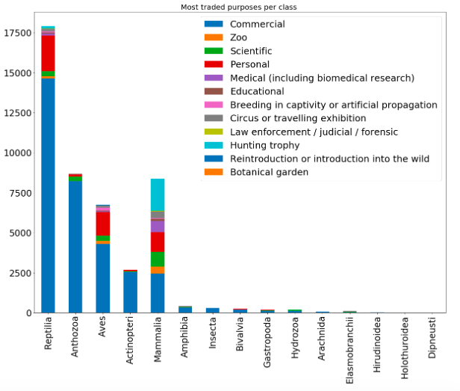
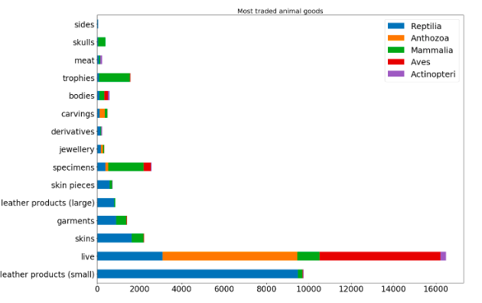
Is the traffic in the big game trophy animals?
No, the big game is in the leather products from reptiles which is mostly traded for commercial purposes.

Slide 8
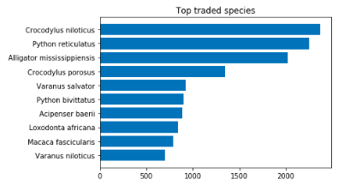
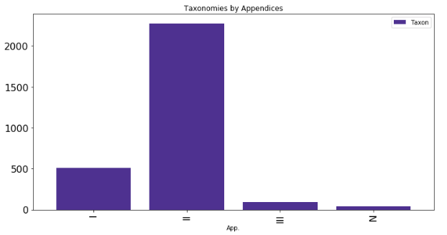
Are the top traded species threatened with extinction?
Threatened with extinction (App I): - Nile Crocodile
- African Elephant
13,026 trades recorded for the 10 top traded species
728 trades recorded for the 2 species threatened with extinction (0.06%)
2,915 kind of taxon were engaged in trading, of which 17,5% are App. I (threatened with extinction)
2225
513
89
38

Slide 9
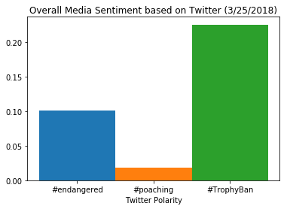
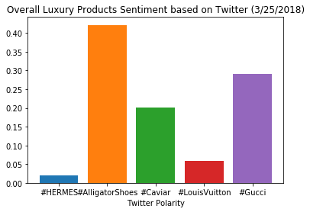
Twitter News/ Sentiment Analysis
There is a positive sentiment related alligator shoes, and a less positive sentiment related to poaching.

Slide 10
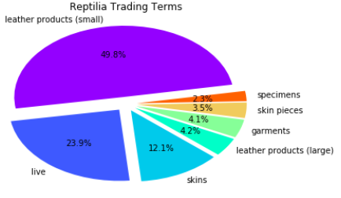
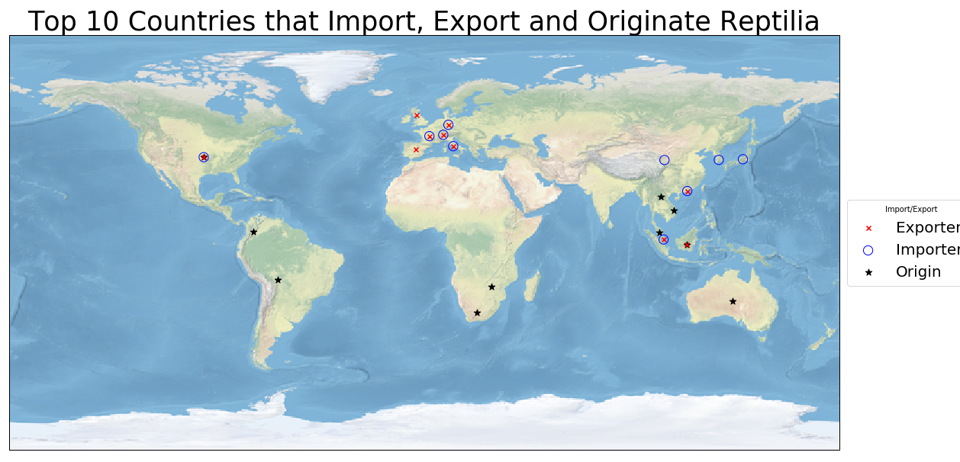
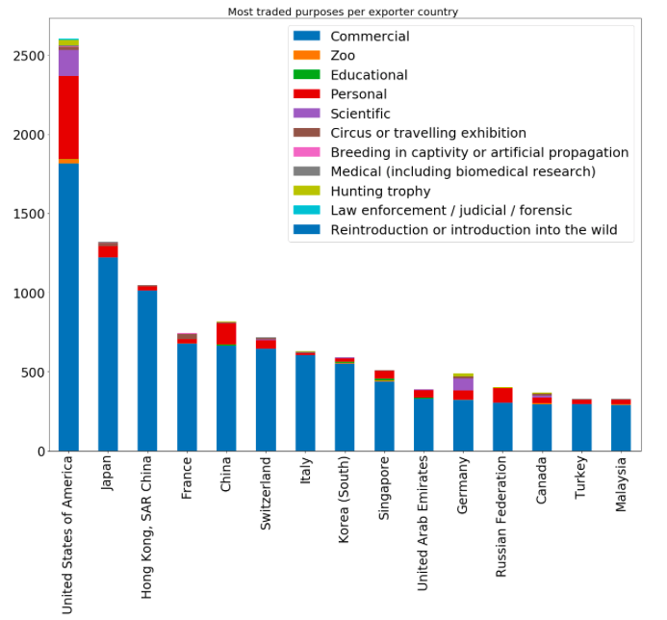
Reptilia Data Overview
Top Importers: US, JP, HK
Top Exporters: IT, FR, US

Slide 11
The GDP per capita over the past 10 years has a direct correlation with the reptile leather product imports/exports for the in the US.

Slide 12
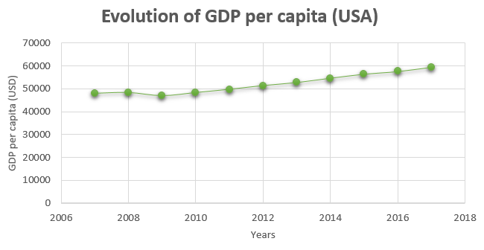
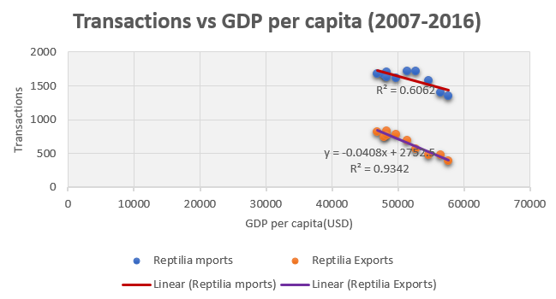
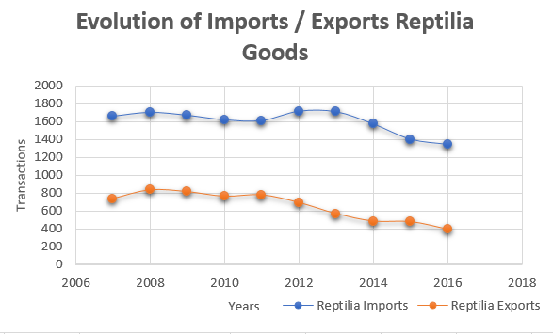
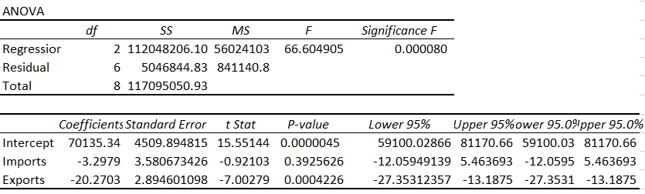
Regression Analysis
R2: 0.98
R2 adj: 0.94

Slide 13
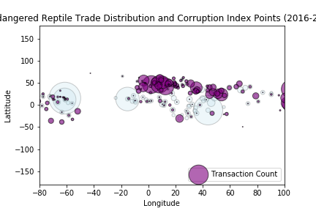
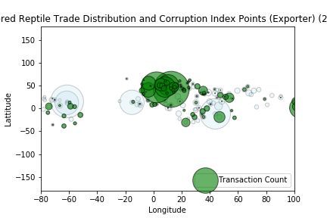
2. The countries with the highest corruption indexes will be the biggest importers/exporters of endangered reptiles for commercial and hunting trophies purposes
Grace was this per importers? What else should I add here?

Slide 14
Other Analysis
Are there more polar bears dying because of high pollution levels than because of trading than poaching?
The elephant population has been reduced from 5MM to 40k over the last 10 years due to poaching. What’s the expected trend for the next 5 years?
Identify the key countries involved in the illegal wildlife trading

Slide 15
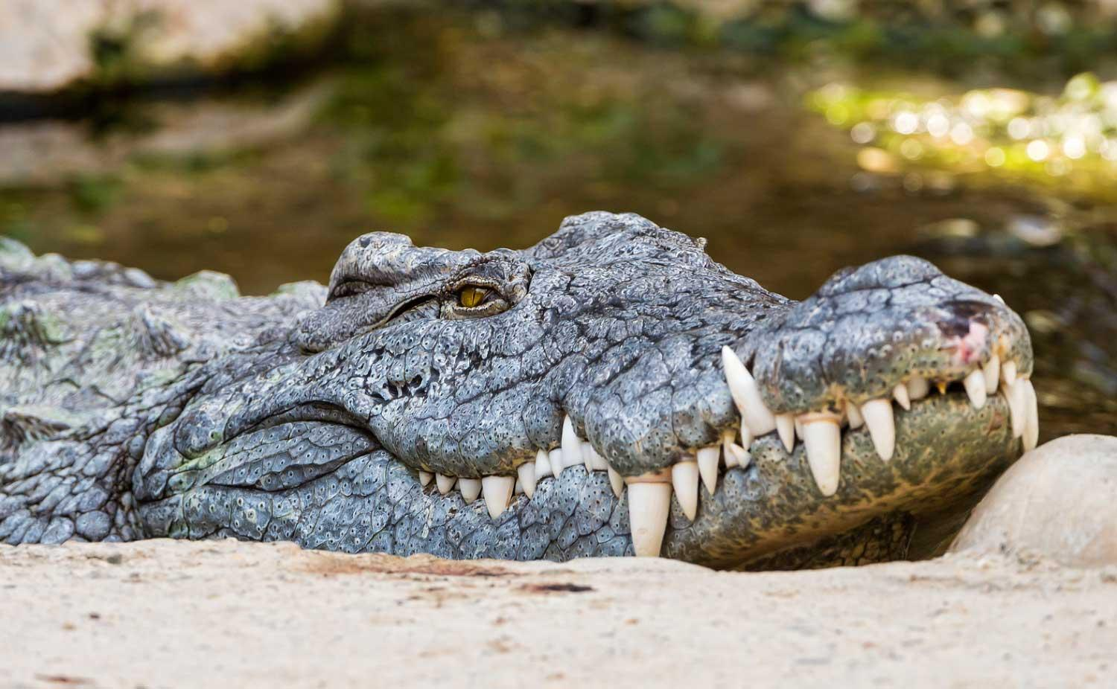
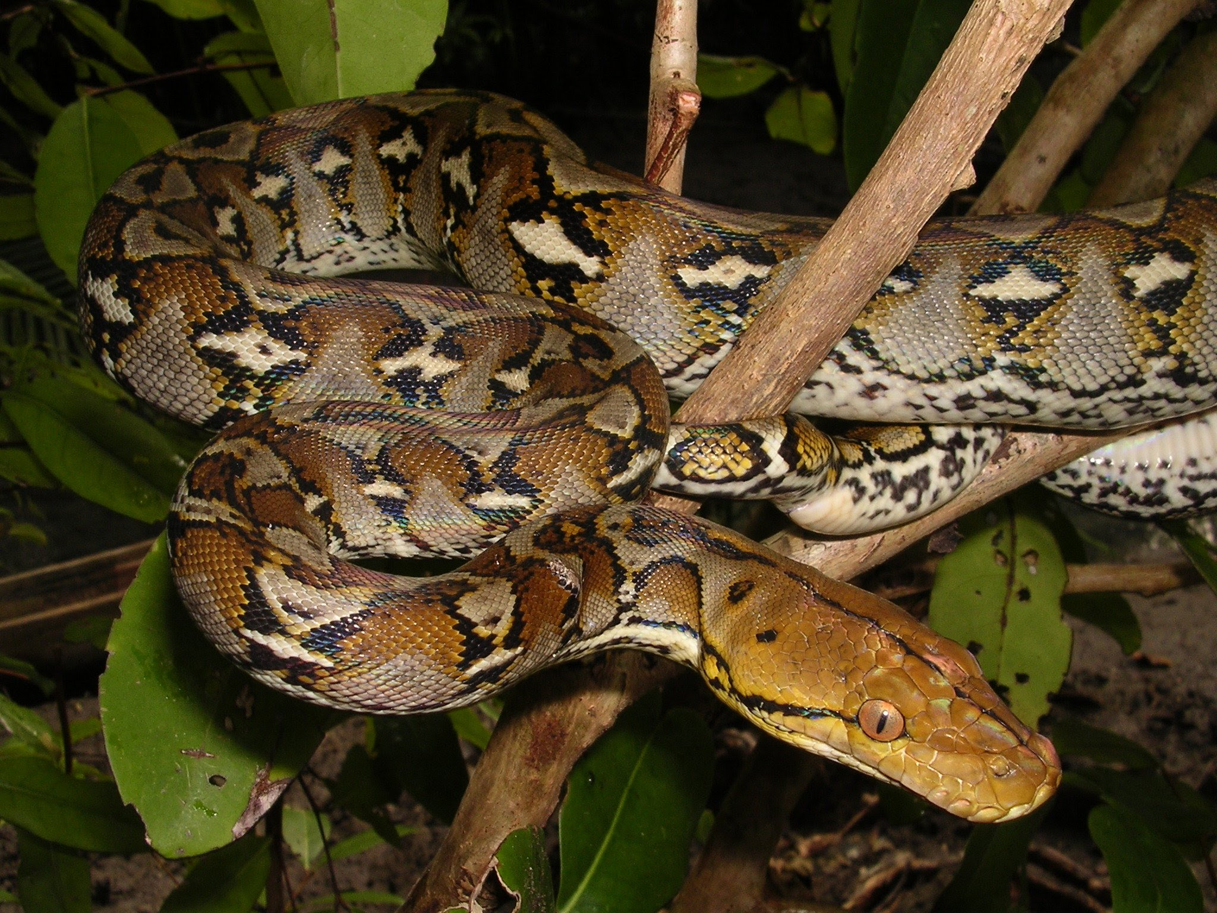
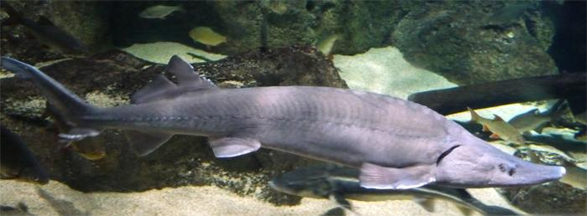

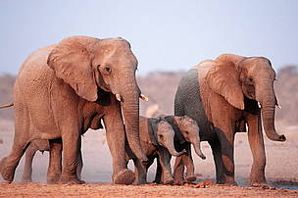
References
CITES Wildlife Trade website: https://trade.cites.org/en/cites_trade/#
ISO Country codes: http://www.nationsonline.org/oneworld/country_code_list.htm
IMF per Capita GDP: http://www.imf.org/external/datamapper/
Illegal Wildlife Trading:
https://www.ncbi.nlm.nih.gov/pmc/articles/PMC4491747/

